Slide 1

Our incineration plant model
A model that is based on TRIDEL data (Lausanne)

Slide 2
Plan
Quick demonstration
Program structure
Model
Results enhancement

Slide 3

Quick demonstration

Slide 4
Program structure
Script parts
Data transfers via CSVs
Self-running program
Code resilience

Slide 5
Data transfers
We could illustrate our previous slide here? Maybe is it superflu?

Slide 6
Model
Start data
Computing data
Output analysis

Slide 7
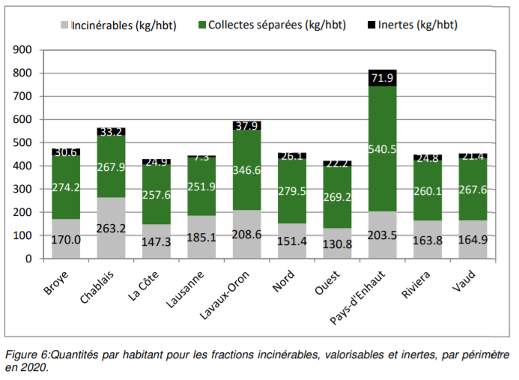
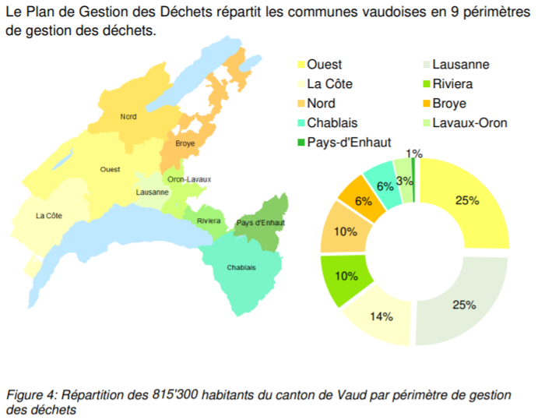
Start data

Slide 8
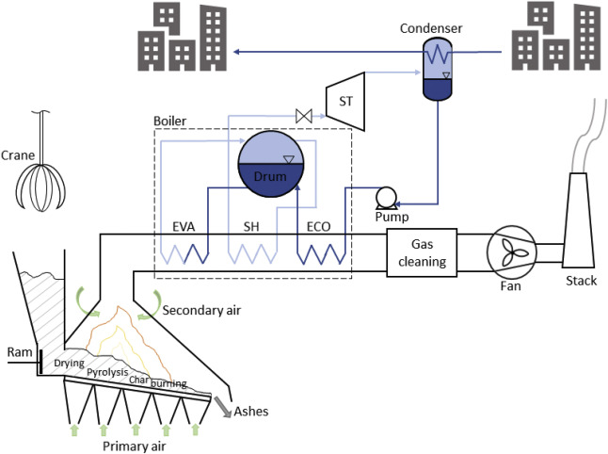
Computing data
Following highlighted part of a standard waste incineration plant

Slide 9
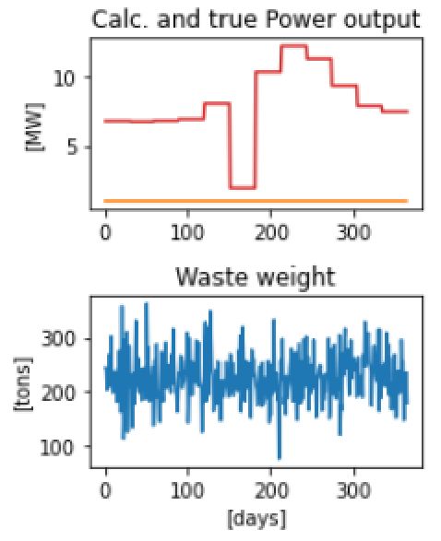
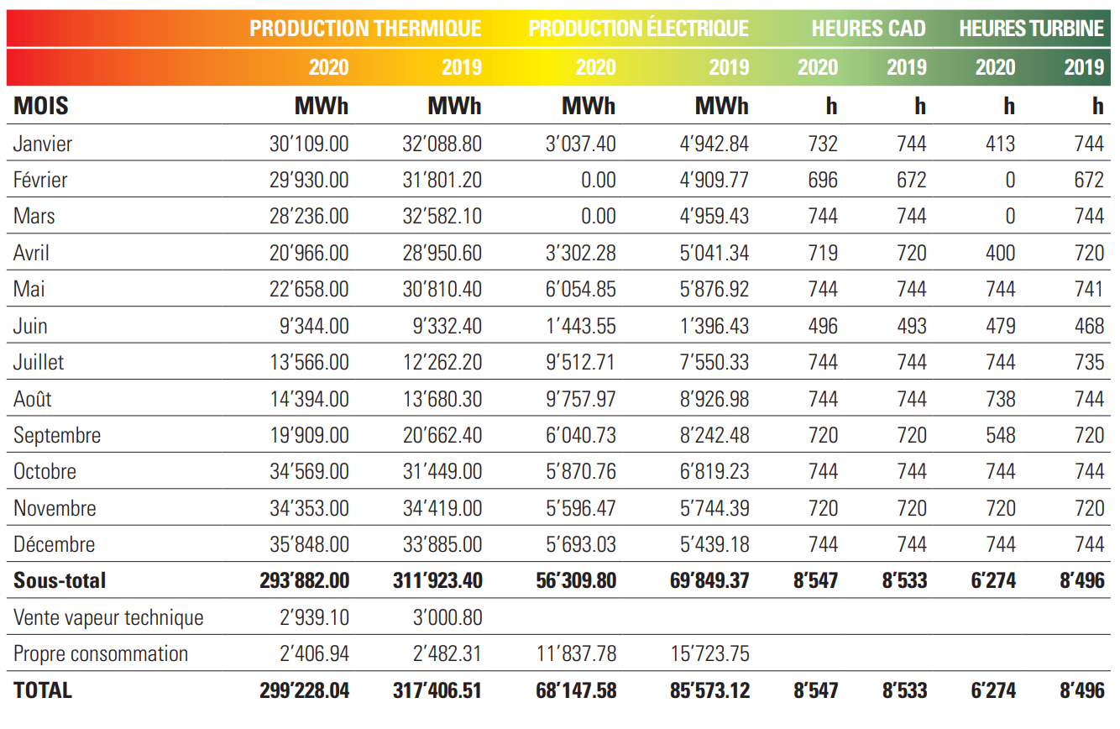
Output analysis
In calculations, parameters are correlated to the extreme: they are obtained from the same data per day…

Slide 10
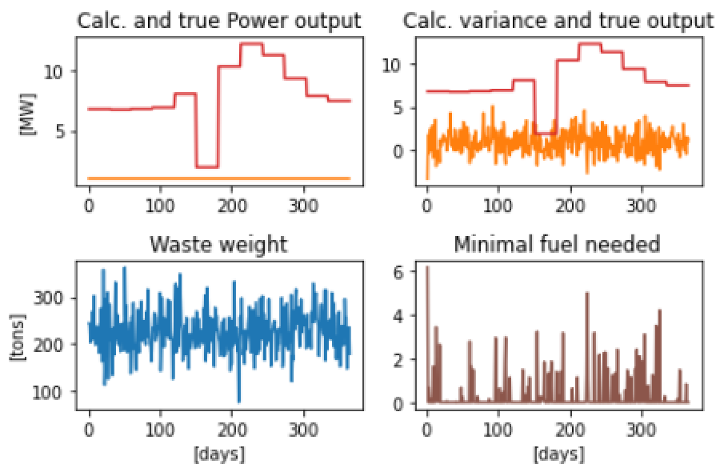
Results enhancement
Adding general variance
New data processing

